Slide 1
Test lists for measuring Internet censorship
applicability, problems and solutions

Slide 2
Workshop structure
What are test lists?
Types and organization
How to clean lists from bad URLs?
How to update lists with fresh entries?
Balancing lists
Potential risks and safety tips

Slide 3

Improving lists of censored online content – project by
“Censorship findings are only as interesting as the sites and services that you test.” (OONI)
Goal: update and clean test list for select states in MENA, CIS, China, Pakistan, Turkey and Iran
Developed detailed methodology how to update test lists (http://netalitica.com/)
Increase the scope of the project to include states in Asia, Africa and Latin America

Slide 4
What are test lists?
Machine-readable files made up of URLs tested for censorship by network measurement tools (e.g. OONI Probe, Centinel)
Include a sample of interesting websites covering most spheres of social life
Jonathan Zittrain, OpenNet Initiative

Slide 5
Types of Test lists
Country
global
CUSTOM
Tested in a specific country
URLs relevant to single country
Predominantly in local language(s)
Tested in all countries
Globally relevant URLs (BBC, UN, Gmail, Google)
Predominantly in English
For specific project
Customizable (OONI Run)
Upstream filtering, geo-political blocking, etc.

Slide 6
Structure of country lists
Include broad range of local sites
Not “Alexa top 1,000” sites
Organized in 30 categories
Not block lists - include blocked, likely to be blocked & not blocked URLs
Help confirm blocking & accessibility of websites

Slide 7
Test list categories
Alcohol & drugs
Anonymization and circumvention tools
Communication tools
Control content
Culture
E-commerce
Economics (economic development)
Environment
File-sharing
Gambling
Gaming
Government
Hacking tools
Hate speech

Slide 8
Test lists categories
Hosting and blogging platforms
Human rights issues
IGOs
LGBT
Media Sharing
News Media
Online dating
Political Criticism
Pornography
Provocative attire
Public health
Religion
Search engines
Sex education
Social networking
Terrorism and Militants

Slide 9
Why bother?
Advance knowledge about Internet censorship
Raise awareness
Keep authorities accountable
Help local testers

Slide 10
Updating lists as a 3-stage process
Review & cleaning “bad” URLs
Adding fresh websites
Balancing

Slide 11
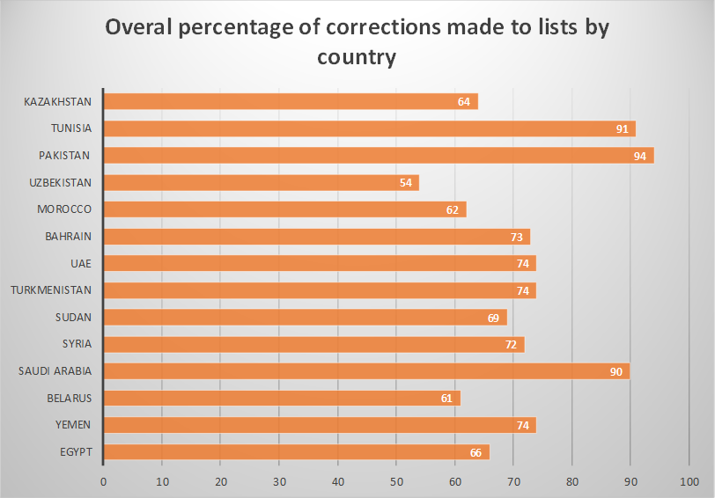
Cleaning from “bad” URLs
Review & cleaning “bad” URLs
Adding fresh URLs
Balancing

Slide 12
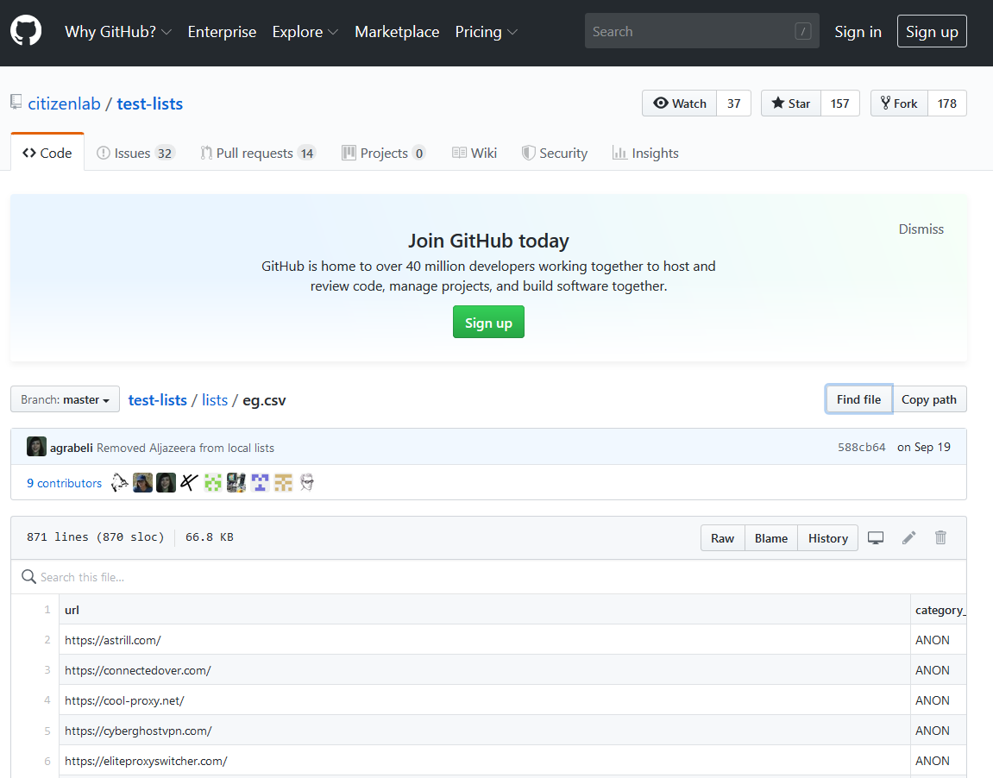
method
Download country list from GitHub
Work with copy of original .CSV file (sample)
Open each URL in your browser
Firefox + Alexa extension
Conduct content analysis of each entry
Record findings & make corrections

Slide 13
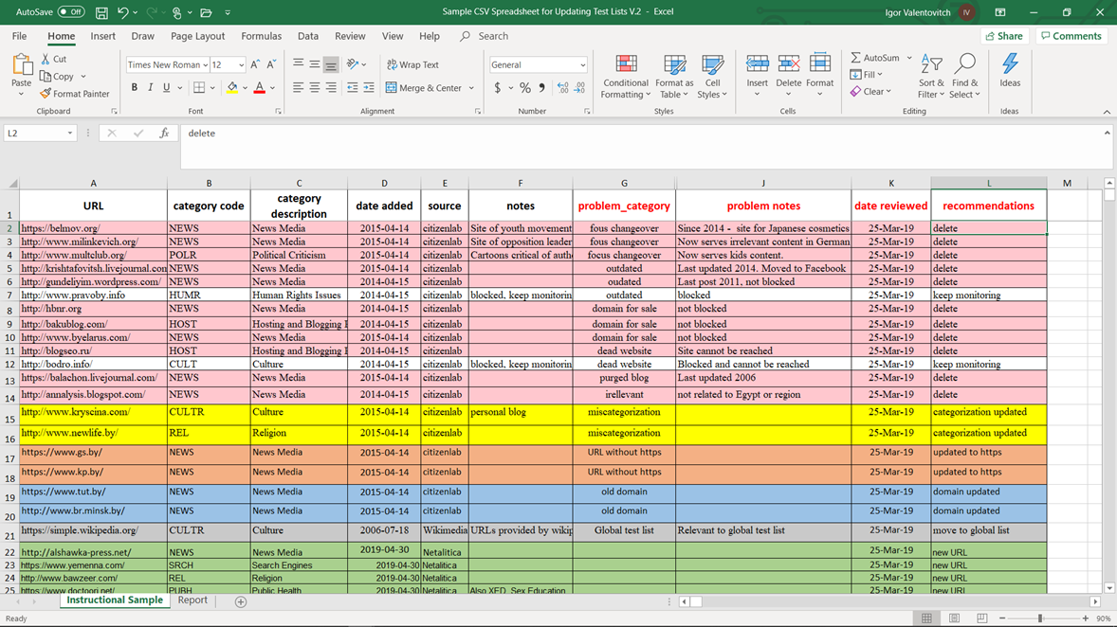

Slide 14
URL problems, categorization and solutions
Focus changeover
Dead websites
Outdated
Domains for sale
Purged blogs and social media channels
Domain redirects
Irrelevant content
Global list
Duplicates
Wrong categorization
Old domain names

Slide 15
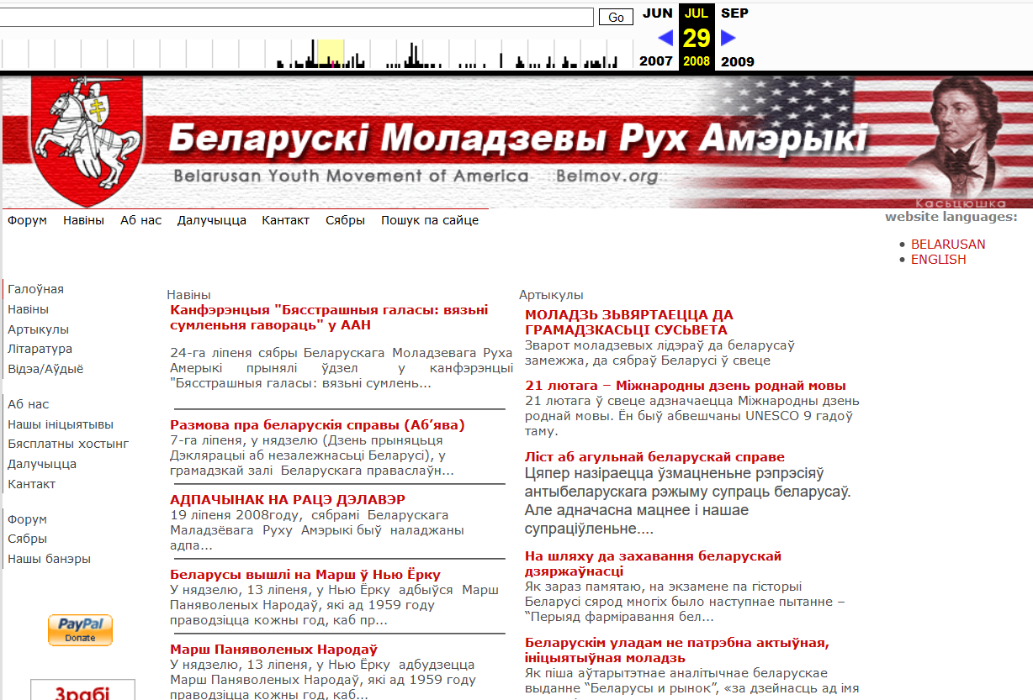
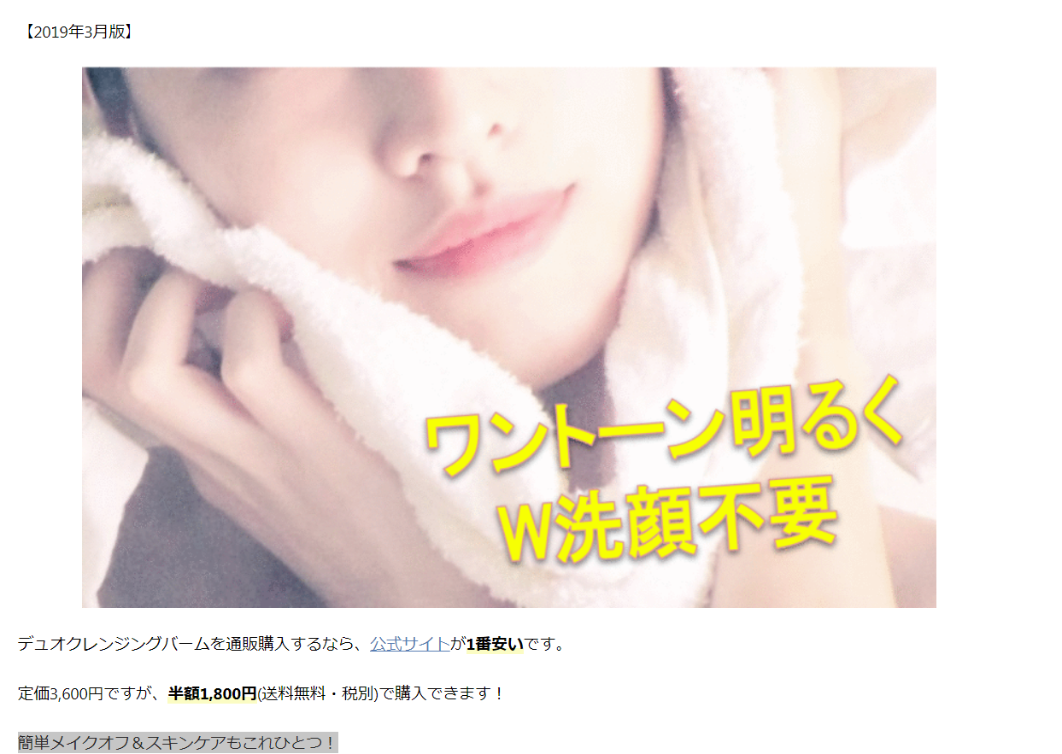
URL problems – focus changeover
now
before
solution
Site of pro-democratic movement from Belarus
Check if site has migrated to a new domain?
Check if site is blocked (OONI Explorer)
Keep blocked URLs
Delete the rest

Slide 16
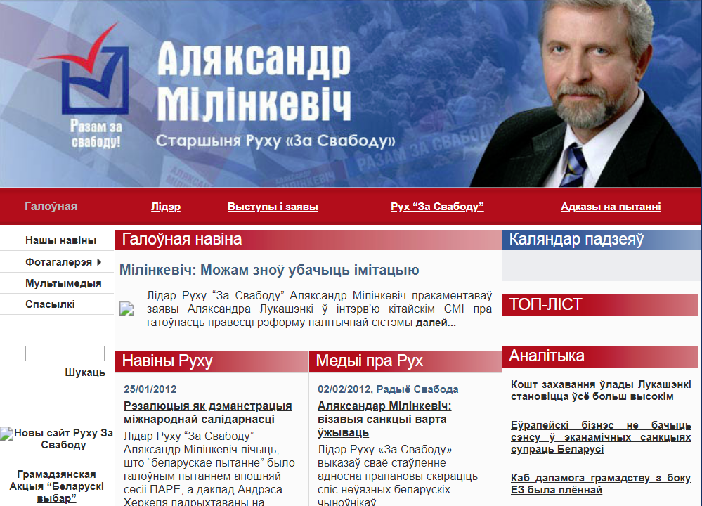
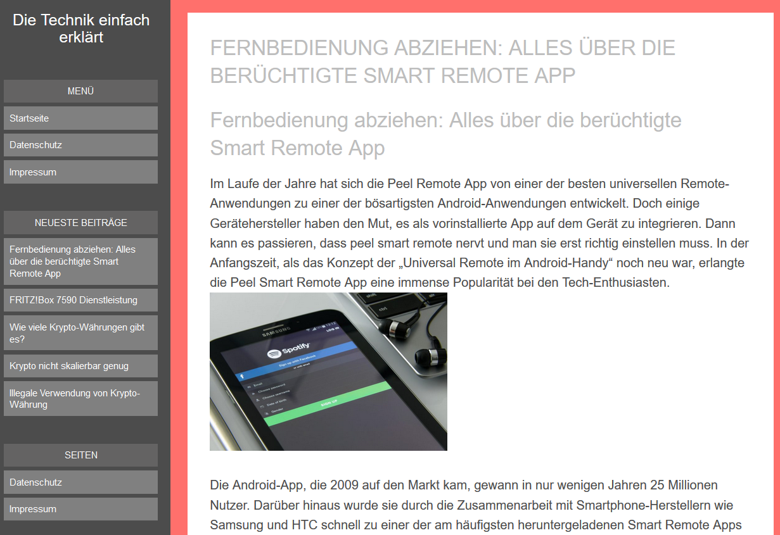
URL problems – focus changeover
now
before
steps
Site of pro-democratic presidential candidate
Present content - irrelevant
May be blocked (OONI Explorer)
=> keep monitoring

Slide 18
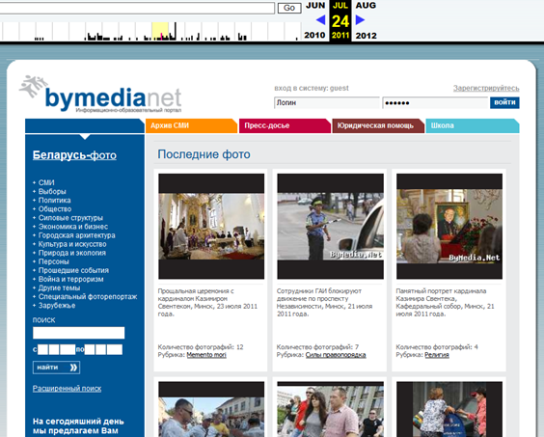
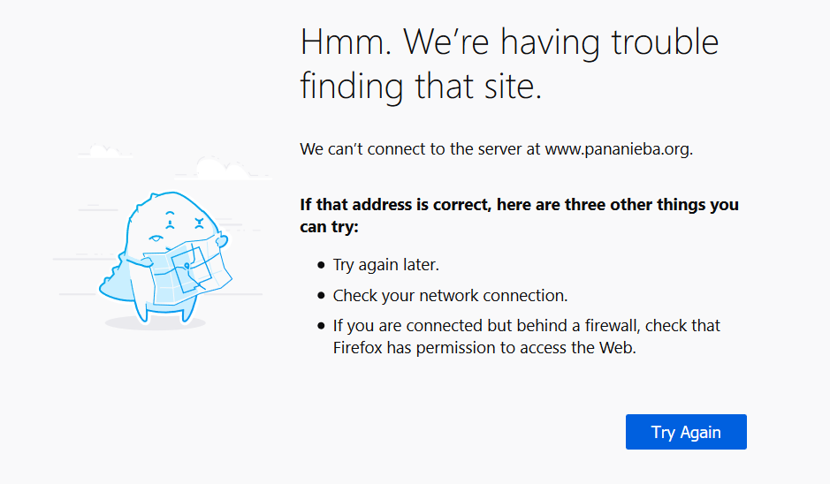
URL problems – dead websites
now
before
solution
Check if site is blocked
Keep monitoring blocked URLs
Delete the rest

Slide 19
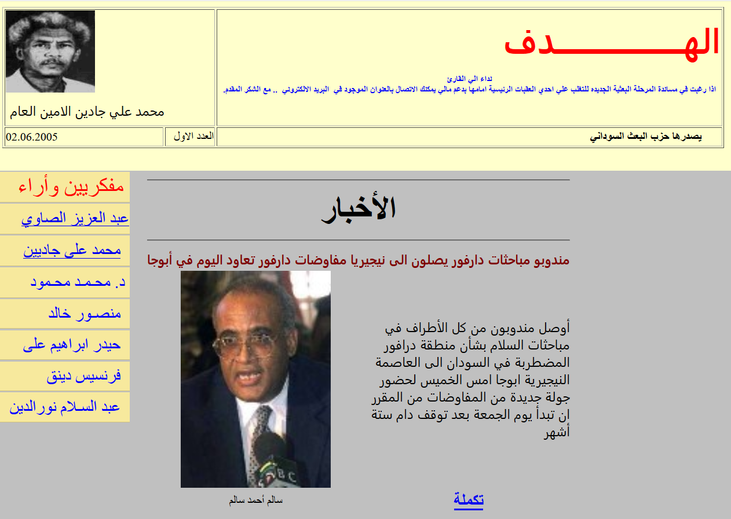
URL problems – outdated websites
Political criticism site (Sudan)
solution
Last updated 2005
Check if site is blocked
Check if still popular (Alexa)
Keep popular & blocked URLs
Delete the rest

Slide 20
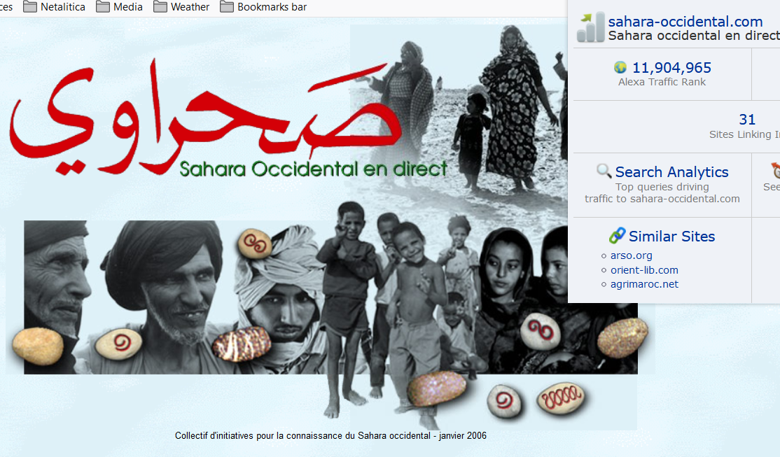
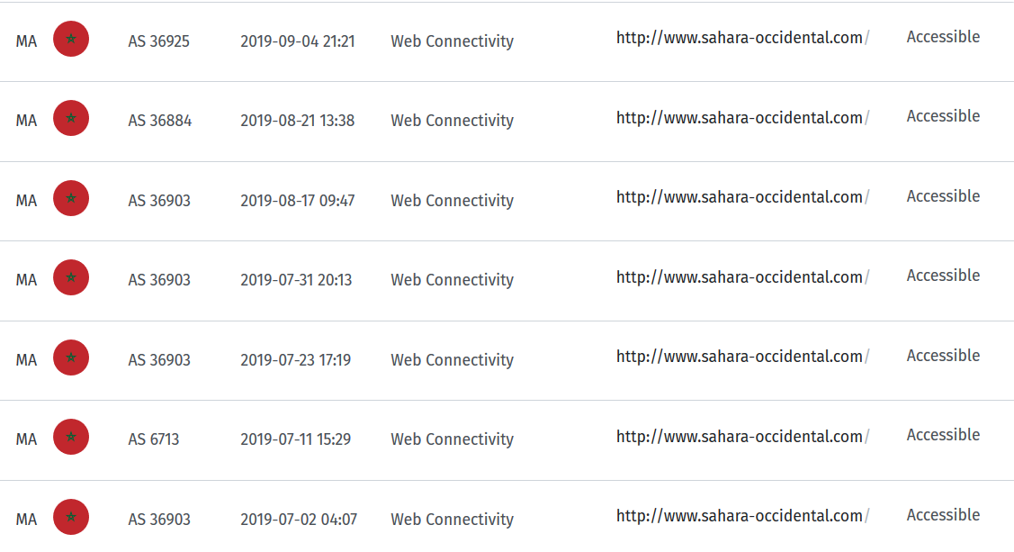
URL problems – outdated websites
Moroccan environmental site
OONI Explorer
solution
Last updated 2006
Not blocked
Low Alexa rank
→ Delete

Slide 21
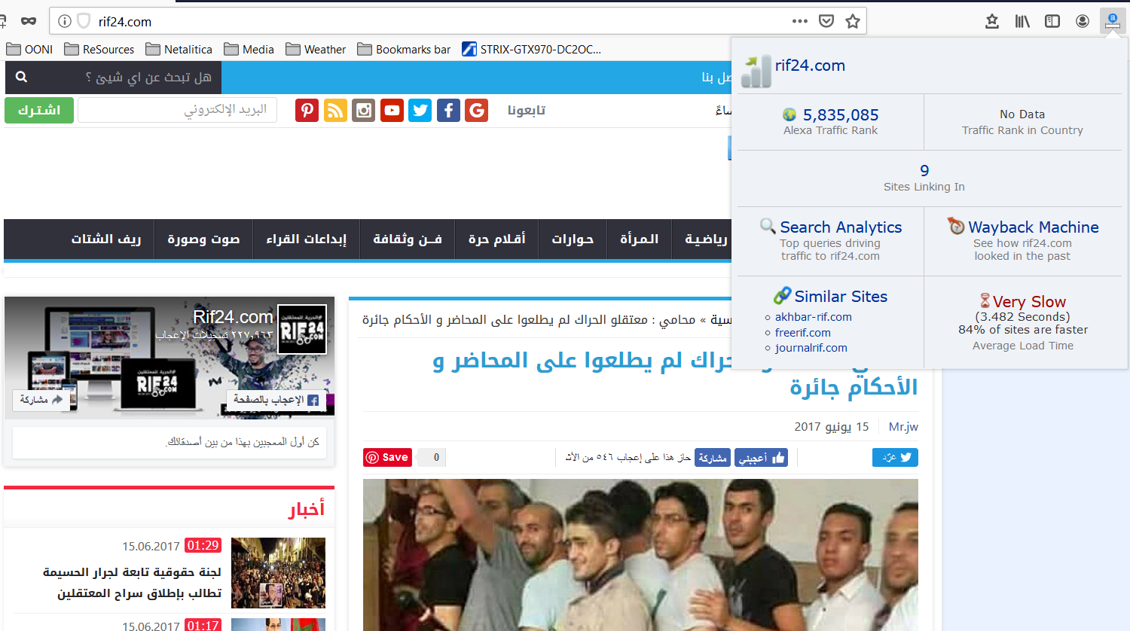
URL problems – outdated websites
Moroccan news site
solution
Last updated 2017
Not blocked
Imprisoned journalists
→ Keep monitoring

Slide 22
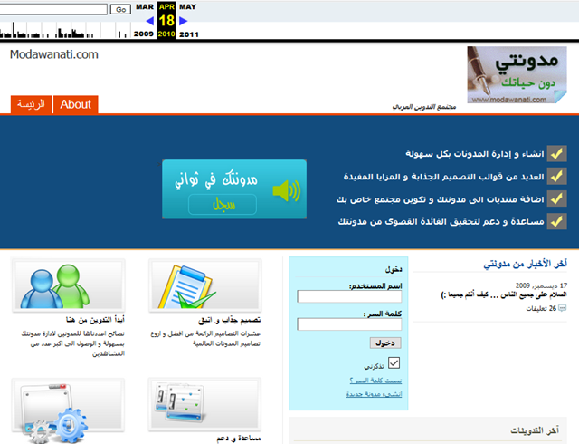

URL problems – domain for sale
now
Before
solution
Blogging platform (Tunisia)
Update URL if site migrated to new domain
→ Delete

Slide 23
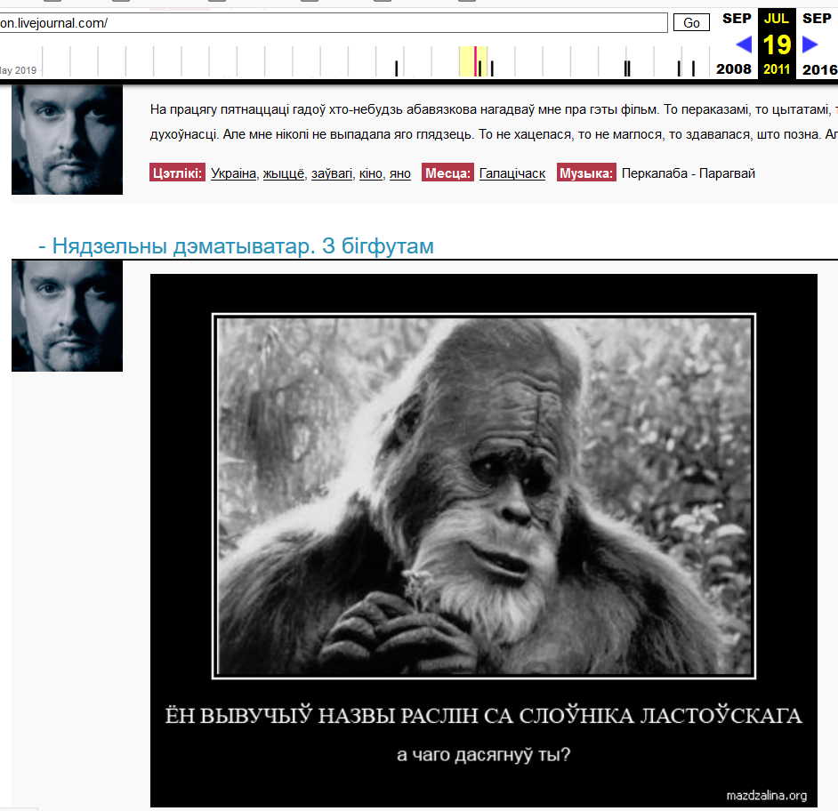
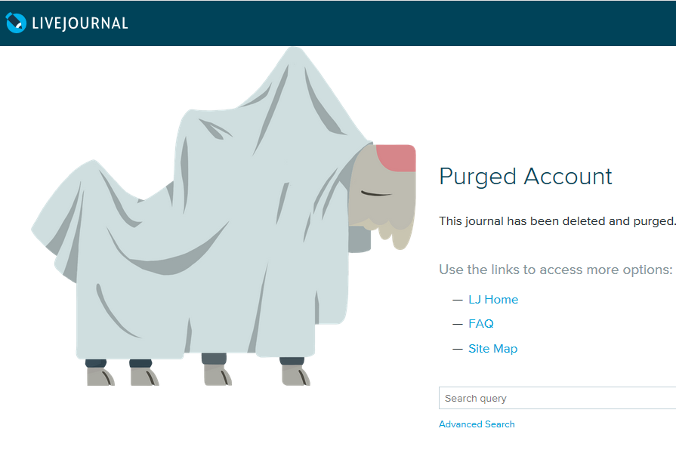
URL problems – purged social media
now
Before
solution
Personal blog
Check if moved to new platform
Delete

Slide 24
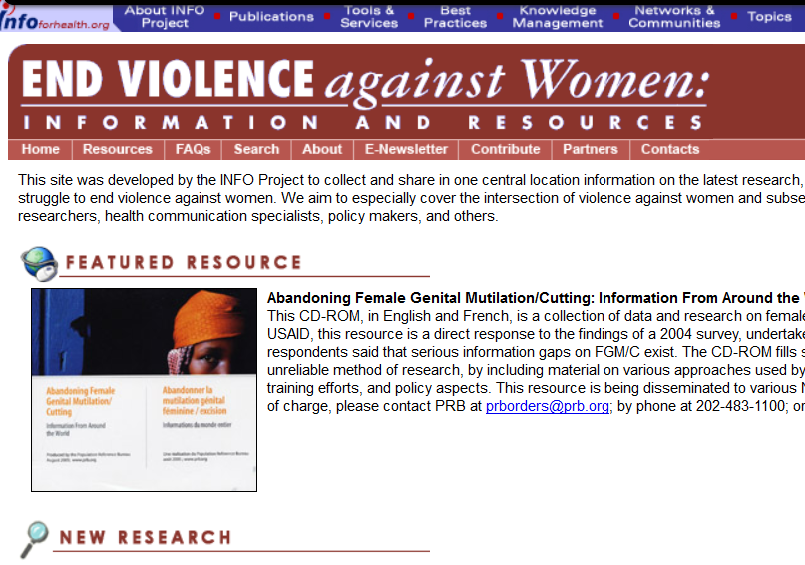
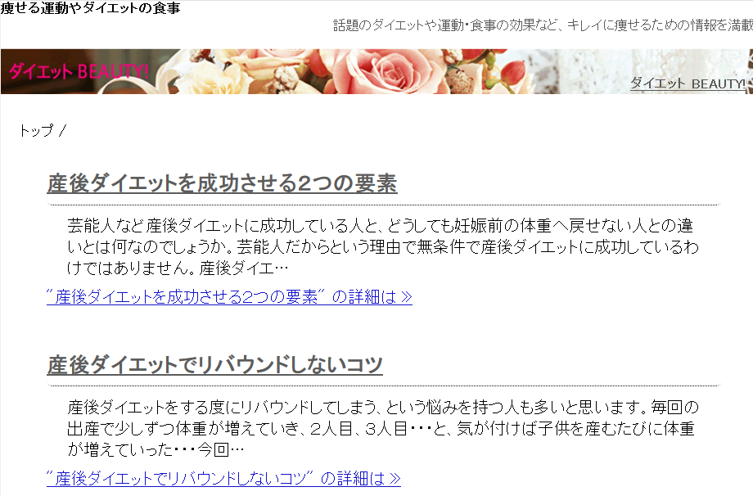
URL problems – Domain redirects
now
Before
solution
Human rights site → irrelevant content
Update URL if site migrated to new domain
Delete

Slide 25
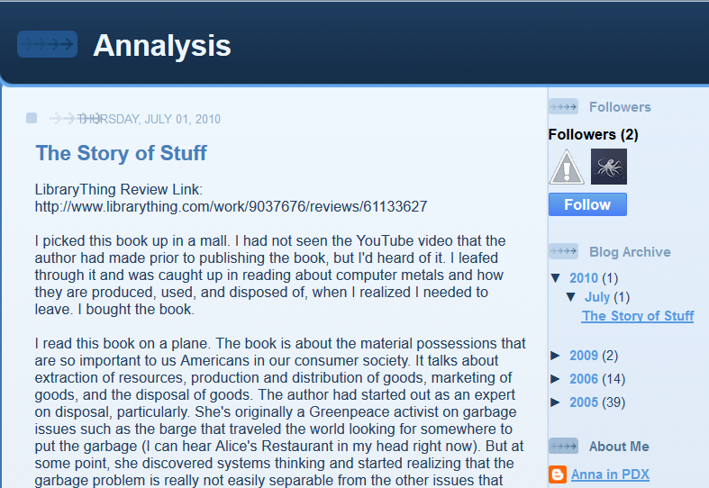
URL problems – irrelevant content
Irrelevant blog post (Egypt)
solution
Delete (if not Control Content)

Slide 26
Other issues
URLs with global relevance (e.g. news, human rights, tools) → move to Global list
Facebook, Twitter & YouTube pages – support HTTPS → delete, keep 10 for control purposes
Duplicates – delete. If site has both HTTP and HTTPS, keep only HTTPS
Categorization - correct if necessary
Old domains – update their URLs

Slide 27
III. Updating lists with new websites
How to Identify fresh URLs?
Research main political, social & economic issues (Wikipedia, World Factbook)
Identify sensitive & prohibited topics → find corresponding websites (Freedom House, OpenNet Initiative, ONI Access)
Identify previously blocked URLs (use URL categories as guide)
Research on Internet censorship topics (Citizen Lab, Internet Monitor)
Reports by global and local (e.g. Sinar Project, Venezuela Inteligente) digital rights organizations
Articles in local & global media
Web-ethnography – online digital rights forums

Slide 28
III. Updating lists with new websites
How to Identify new URLs?
Social media channels of activists and communications authorities
Outreach to targeted platforms & local digital rights organizations
Analyze national block lists (if available)

Slide 29
III. Updating lists with new websites
How to enter new URLs?
Add URLs exactly as they appear in your browser (e.g. https://tacticaltech.org/)
If given website has both HTTP and HTTPS addresses, enter only HTTPS
Websites with many pages: add URL of home page and country-specific services (e.g. BBC Russia)
When entering a new URL, include:
  category code (e.g. NEWS) and description (e.g. News Media)
  date in proper format (YYYY-MM-DD)
  Contributor – optional
  Notes – useful information about added URL

Slide 30
III. Updating lists with new websites
How to enter new URLs?

Slide 31
IV. Balancing test lists
Internal balance (within categories) – each category should include blocked and not blocked URLs
External balance (between categories) – each category should include representative number of URLs (20-40)
Naturally, some categories (e.g. political criticism, news media) are more populated than others (e.g. porn)

Slide 32
V. safety
Updating test lists may be risky in some countries
Encrypt your communication with Open PGP (instructions for PC and Mac)
Use Tor browser
Use a reliable VPN (e.g. Psiphon)
Check digital security resources: Security Planner, Security in a Box, Digital Hygiene, etc.

Slide 33
Improving lists of censored online content – Netalitica@gmail.com
Latin America
Bolivia
Brazil
Colombia
Cuba
Ecuador
Nicaragua
Venezuela
Asia
India
Indonesia
Malaysia
Hong Kong
Myanmar
Singapore
Thailand
Vietnam
Africa
Burundi
Cameroon
Ethiopia
Kenya
South Africa
Uganda
MENA
Algeria
Iraq
Lebanon
Palestine Territories
Qatar

